Slide 1



DATA-DRIVEN INNOVATION: TESLA'S SUCCESS STORY IN THE AUTOMOTIVE INDUSTRY

Slide 2

CONTENT
01
INTRODUCTION
02
WHAT IS BUSINESS ANALYTICS?
03
WHY IS BUSINESS ANALYTICS NECESSARY IN THE AUTOMOTIVE INDUSTRY?
04
IMPORTANCE OF BIG DATA IN TESLA INC.
05
DATA SOURCES AND COLLECTION
06
CUSTOMER ANALYTICS
07
FINANCIAL ANALYTICS
08
COMPETITIVE ANALYTICS
09
CONCLUSION

Slide 3




INTRODUCTION
Tesla, Inc., formerly (2003–17) Tesla Motors, American manufacturer of electric automobiles, solar panels, and batteries for cars and home power storage.
It was founded in 2003 by American entrepreneurs Martin Eberhard and Marc Tarpenning and was named after Serbian American inventor Nikola Tesla.

Slide 4

WHAT IS BUSINESS ANALYTICS
Business analytics is the practice of analysing data to gain insights and inform decisions. It involves collecting and processing data, using various techniques to uncover trends and patterns, and making data-driven decisions. This process can include descriptive, diagnostic, predictive, and prescriptive analytics. Data visualisation is key for communicating findings, and it supports decision-making, strategy development, and continuous improvement. Successful business analytics fosters a data-driven culture, enabling organisations to adapt to changing conditions and make informed choices.

Slide 5
WHY IS BUSINESS ANALYTICS NECESSARY IN THE AUTOMOTIVE INDUSTRY?
Business analytics is the practice of analysing data to gain insights and inform decisions. It involves collecting and processing data, using various techniques to uncover trends and patterns, and making data-driven decisions. This process can include descriptive, diagnostic, predictive, and prescriptive analytics. Data visualisation is key for communicating findings, and it supports decision-making, strategy development, and continuous improvement. Successful business analytics fosters a data-driven culture, enabling organisations to adapt to changing conditions and make informed choices.

Slide 6

WHAT IS THE DATA DRIVEN SUCCESS OF TESLA?
Though Tesla is an automotive and energy company of which around 90% revenue comes from cars and 10% from their energy business. But the company is often referred to as a "data company" because it collects, analyses, and utilises vast amounts of data in various aspects of its business. This data play a vital role inside Tesla’s car self driving feature Tesla’s customer act as a beta tester to gain data and the company also gains 20% gross profit on sales of each Tesla car on the other hand, Tesla’s competitors like “Google Waymo“ have to spend money for collecting more road miles data.

Slide 7
DATA SOURCE AND COLLECTION
Vehicle Sensors
Customer Data
Market Data Insights
Telematics Data
Autonomous Driving Data
Data Storage

Slide 8

VEHICLE SENSORS
CUSTOMER DATA
MARKET DATA INSIGHTS
Tesla's autonomous driving technology uses sensors like radar, ultrasonic sensors, and cameras to gather real-time data on vehicle speed, road conditions, and object detection for navigation and decision-making.
Tesla uses customer data on charging, driving behaviour, service requests, and user feedback to optimise vehicle features and improve user experiences.
Tesla utilizes market data to stay responsive to industry trends, competition, and consumer preferences, informing product strategies, pricing, and marketing to thrive in the automotive sector.
TELEMATICS DATA
AUTONOMOUS DRIVING DATA
DATA STORAGE
Tesla's telematics systems send vehicle health, diagnostics, and performance data to Tesla's servers, allowing remote monitoring, maintenance prediction, and efficient over-the-air software updates for improved vehicle functionality and issue resolution.
Tesla's autonomous driving effort relies on data from vehicle sensors and cameras to improve technology through machine learning.
To handle the automotive data, Tesla uses data centers with redundancy and backup, cloud storage, and advanced databases for efficient organization and access, ensuring data integrity and availability.

Slide 9
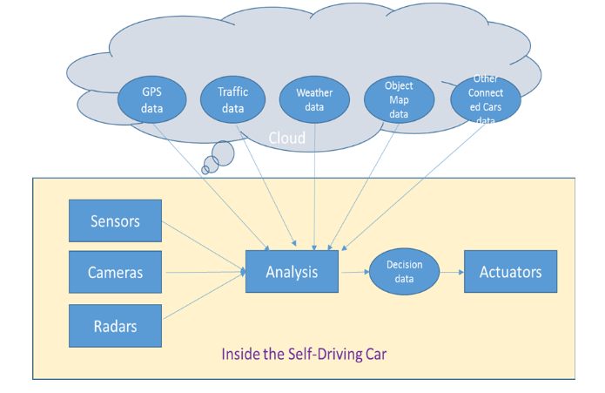

Slide 10


DATA ANALYSIS AND PROCESSING
In the development of self-driving cars, the analysis and processing of data play a pivotal role. Tesla employs advanced data analytics techniques and tools to make sense of the vast amount of data collected from its vehicles and sensors. Here's the techniques Tesla uses for data analysis an processing:
Data Mining
Real-Time Data Analysis
Data Cleaning and Transformation
Machine Learning Models
Predictive Analytics
AI-Enhanced Decision-Making
Map Data Integration

Slide 11
Data Mining: Tesla engages in data mining to extract valuable insights from the extensive datasets generated by its vehicles. This process involves discovering patterns, correlations, and anomalies within the data, which can inform various aspects of autonomous driving, from safety improvements to route optimization.
Real-Time Data Analysis: Real-time data analysis is paramount for autonomous driving. Tesla's systems continuously analyze data from sensors and cameras, enabling vehicles to make instant decisions in response to changing road conditions. This real-time analysis is critical for the safety and efficiency of self-driving cars.
Data Cleaning and Transformation: Raw data collected from vehicles may contain errors, inconsistencies, or irrelevant information. Tesla applies data cleaning and transformation techniques to ensure the data is accurate and relevant for machine learning and AI applications. Clean and well-structured data is essential for training models effectively.
Machine Learning Models: Tesla relies on machine learning models to process and interpret data from sensors and cameras. These models are responsible for tasks such as object detection, path planning, and collision avoidance. Continuous refinement of these models is essential for enhancing the performance of self-driving technology.

Slide 12
Predictive Analytics: Predictive analytics is employed to anticipate potential road hazards and challenges. By analyzing historical data and real-time inputs, Tesla's self-driving technology can predict and mitigate problems before they occur. This capability contributes to the overall safety and reliability of self-driving cars.
AI-Enhanced Decision-Making: The data analysis process informs AI systems that make critical decisions while driving. These AI systems consider real-time data, traffic conditions, weather, and other variables to ensure the safe operation of self-driving vehicles. The ability to analyze data and make rapid decisions is a key feature of autonomous cars.
Map Data Integration: In addition to real-time data, Tesla integrates map data into its analysis process. Maps provide valuable information about road layouts, traffic signs, and navigation, allowing self-driving cars to make more informed decisions. Tesla's high-precision maps enhance the accuracy of autonomous driving.

Slide 13
CUSTOMER ANALYTICS
Tesla priorities understanding its customers to enhance their experience and satisfaction. Leveraging the wealth of data collected from vehicle usage and owner interactions, Tesla employs customer analytics to gain deep insights into driver behaviour, preferences, and feedback.
These are the customer segments of Tesla:
High-end Luxury (Sedan or SUV)
Mid – price range
Commercial Vehicles – targeted towards transportation and shipping businesses
Green Community
Fast sports car enthusiast
Autopilot enthusiast
Tesla Followers
Elon Musk Followers

Slide 14
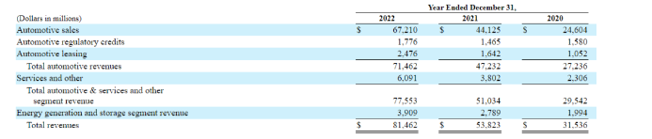
SUPPLY CHAIN OPTIMIZATION
In 2022, Tesla achieved a remarkable financial milestone, reporting a total revenue of $81.46 billion, marking a substantial increase of $27.64 billion compared to the previous year. To gain a deeper understanding of Tesla's financial performance, it's essential to dissect the company's revenue sources.
Following is the chart showing the sales and revenue insights of Tesla Car Company.

Slide 15
COMPETITIVE ANALYTICS
Tesla, a pioneering electric vehicle and clean energy company, operates in a dynamic market with fierce competition. This section delves into Tesla's main competitors and their strategies.
Key Competitors:
Ford Motor Company
General Motors (GM)
NIO Inc.
Volkswagen
Google’s Waymo

Slide 16
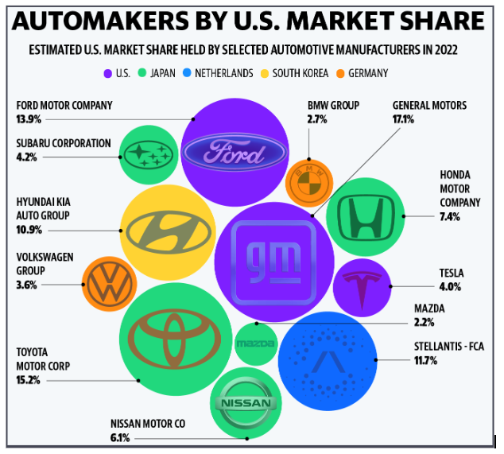
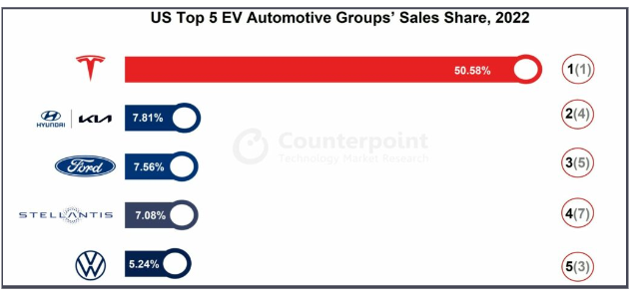
MARKET SHARES OF DIFFERENT AUTOMAKERS IN US
Overall Tesla holds 4% market shares in US market till 2022 and in electric vehicles sector Tesla holds more than 50 percent shares.

Slide 17
FINANCIAL ANALYTICS
Tesla, the renowned electric vehicle and clean energy company, has experienced remarkable growth in recent years, reflected in its stock price and market capitalisation.
Stock Performance:
Tesla's stock price has witnessed substantial growth over the past decade, from $33.87 per share at the end of 2012 to approximately $1,077.60 at the end of Q1 2022.
Capital Structure:
Tesla's capital structure and financial health have evolved. In 2018, its debt-to-equity (D/E) ratio was 3.71. By the end of 2021, it reduced to 1.01.
Earnings and Profitability:
In Q4 2021, Tesla reported a quarterly earnings-per-share of $2.05, a company record. The company's profit margin also significantly improved.

Slide 18
COST STRUCTURE OF TESLA
The following are Tesla expense and cost structure -
Cost of Goods and Services (COGS): $20.509 Billion equal to 83% of the revenue
Selling, General & Administrative Cost: $2.646 Billion equal to 11% of the revenue
Research & Development Cost: $1.343 Billion equal to 6% of the revenue
Restructuring Cost: $149 Million equal to less than 1% of the revenue
Interest Expense, Taxes, and Others: approx. 3% of revenue
Automotive Segment revenue –
Vehicle sales: $19.952 Billion
Vehicle leasing: $869 Million
Total: $20.821 Billion
Total Revenue from Energy Generation & Storage: $1.531 Billion
Services – Includes car services, repairs, consultations, and other general services
Total Revenue from Services and other: $2.226 Billion

Slide 19
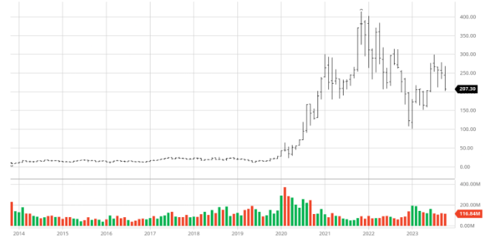
DATA VISUALIZATION
Following is the chart to understand stock market trends of tesla:

Slide 20

CONCLUSION
Tesla's success in the electric vehicle industry is attributed to their strategic use of data and business analytics. They rely on data for product innovation, supply chain optimization, predictive maintenance, market expansion, financial analysis, and sustainability efforts. This data-driven approach helps them stay competitive, efficiently manage their operations, and maintain their market leadership.

Slide 21
THANK YOU

